Slide 1
Federal Reserve System
SOL13d
Produced by Costa Inc.
www.patcosta.com

Slide 2
Objectives
By the end of this lesson you should be able to explain the four roles of the Federal Reserve System.

Slide 3
VOCAB GOES HERE

Slide 4
VOCAB REVIEW GOES HERE

Slide 5
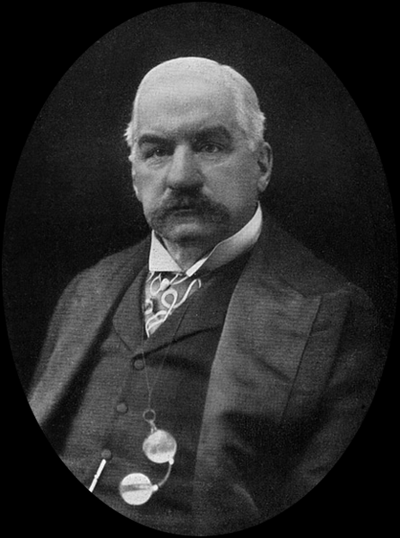
Federal Reserve Background
In 1907 there was a financial panic in the United States. Many people lost millions of dollars.
To stabilize the economy J.P. Morgan, a famous banker along with other business leaders pledged money to support the economy.
Source: http://commons.wikimedia.org/wiki/File:JohnPierpontMorgan.jpg

Slide 6
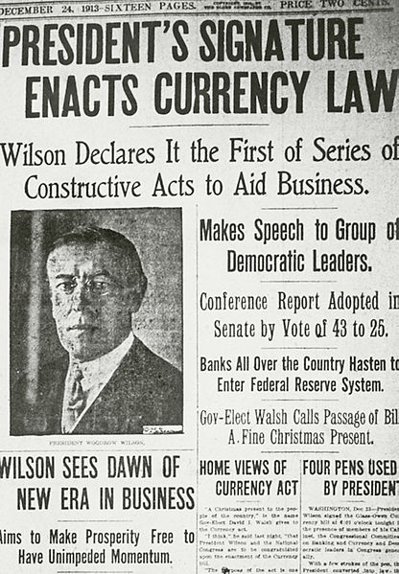
Eventually J.P. Morgan and others were able to use their money to restore the economy back to health.
However, the Panic of 1907 suggested to political leaders that something more needs to be done to prevent a future occurrence.
That “something more” was the creation of the Federal Reserve System, signed into law in 1913 by President Woodrow Wilson.
Source: http://en.wikipedia.org/wiki/File:Fed_Reserve.JPG

Slide 7
QUIZ 1 GOES HERE

Slide 8
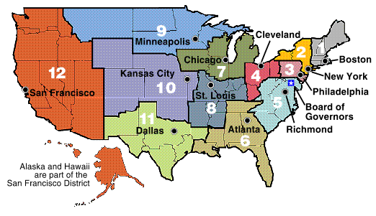
Structure of the Federal Reserve
There are 12 Federal Reserve Banks across the United States. Each covers a district.

Slide 9
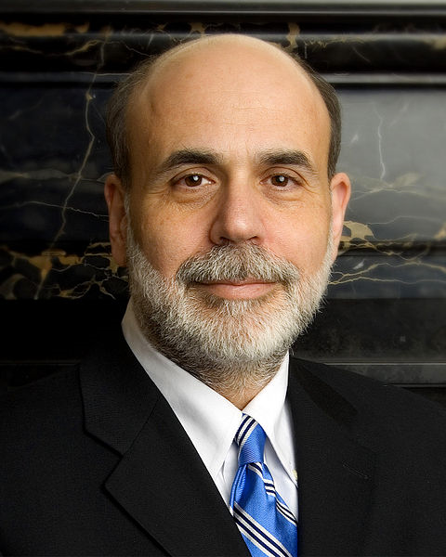
The Federal Reserve is controlled by a seven member board of governors.
As part of our government’s system of checks and balances, those seven members must be appointed by the president and approved by the Senate.
From those seven members the president picks one to led the board for a four-year term.
The current leader of the
Federal Reserve is Ben Bernake.
Source:
http://en.wikipedia.org/wiki/
File:Ben_Bernanke_official_portrait.jpg

Slide 10
The board of governors select members the leaders for each of the 12 Federal Reserve regional banks. They also participate in managing the nation’s money supply.
The Federal Reserve has its own budget separate from the national government. The Federal Reserve makes money charging services for U.S. banks and having banks invest in it.
This helps the Federal Reserve System make perform its functions while being free from political pressure.

Slide 12
QUIZ 2

Slide 13
Functions of the Federal Reserve
The Federal Reserve has four basic jobs.
1. It has a duty to maintain the value of the national currency.
2. To regulate banks to ensure soundness of banking system and safety of deposits
3. Manages the amount of money in the economy to keep inflation low and prevent recessions.
4. Act as the federal government’s bank.

Slide 14
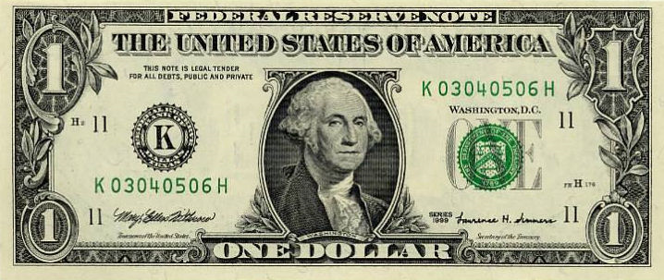
Value of National Currency
To maintain the national currency the Federal Reserve will issue new coins and paper dollars. The money itself is produced by other government agencies but the Federal Reserve can control the circulation. The Fed also has the responsibility for replacing damaged currency with new ones.
The origin of each dollar is printed on it.
If you look to the
left-hand side of the
dollar you will notice
a letter “K.” Each dollar
has a letter that indicates
where the dollar bill was
circulated from.
In this example,
“K” means the
Federal Reserve
Bank of Dallas.

Slide 15
Regulating
The Federal Reserve deals with regulating banks and protecting consumer credit.
The Fed as a say in whether or not banks can merge together.
The Fed also regulates interactions between American and foreign banks.
Lastly, the Federal Reserve can also require banks to provide details of a loan before consumers borrow money.

Slide 16
Managing
A huge responsibility of the Federal Reserve is ensuring that our nation’s supply of money is balanced. In other words it the Fed adds money if there is too little and takes money out if there is too much.
Too much money in our nation is called inflation. This occurs when prices rise too fast and items begin to cost a lot more. Consumers can not buy the high priced items and business see profits decline. Employees start to lose jobs.
Too little money in our nation is called recession. This occurs when prices fall too fast and items becomes cheaper. Business are then unable to make a profit and workers start losing their jobs.

Slide 17
The trick for the Fed is to find the right balance between inflation and recession.
Think of the Fed like a car. You don’t want to go too fast or you risk getting into an accident or a speeding ticket. However, you do not want to go too slow or else you risk getting run off the road. You need to maintain a stable speed.
The Federal Reserve operates just like the car, it seeks to drive the nation’s economy at a stable speed. Not too fast but not too slow.

Slide 18
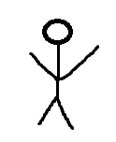
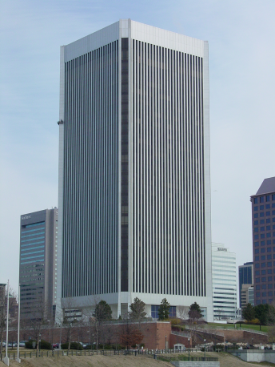
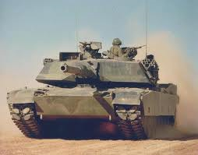
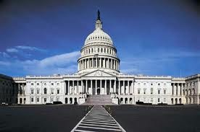
Government’s Bank
The last function of the Federal Reserve is to act as the US Central Bank.
The US government deposits money into the Federal Reserve.
The Fed sells bonds, which allows the US government to buy items.
You give the Federal Reserve
100 dollars. In return you get a bond . The bond is a promise that within 10 years you
bring it back to the bank and you get 110 dollars.
The US government then
buys things it needs. For example, a new tank for the military.
The US government then
borrows that 100 dollars. It promises
to pay it back with interest.
The Federal Reserve
deposits the bond into
its accounts.

Slide 19
QUIZ 3

Slide 20
VIDEO QUIZ
In this section you will be reviewing a video. These are the questions that you need to answer following the video.
1. What is every dollar a part of?
2. What is the Fed?
3. How many Federal Reserve Banks exist?
4. Who appoints the leaders of the Federal Reserve System? Who approves?
5. What is the Federal Reserves main goal?
6. What term is used to describe when there is too much money and too much consumer demand?
7. What term is used to describe when there is too little money and too little consumer demand?
8. One way the Fed can control the amount of money is through the buying and selling of government___________________________________.
9. What is the Feds main aim? Why might that be important?
10.What is the Fed often called? Why?

Slide 21
The Fed Today Video
Instructions: Click on the video to start it.

Slide 22
Quiz 4

