Slide 1
League of Nations: Cartoon Analysis
With discussion questions

Slide 2
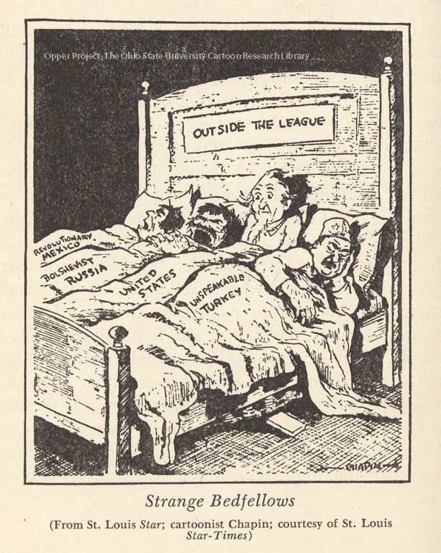
1
Notes:
What countries are not in the league? What does the cartoon suggest about the US?

Slide 3
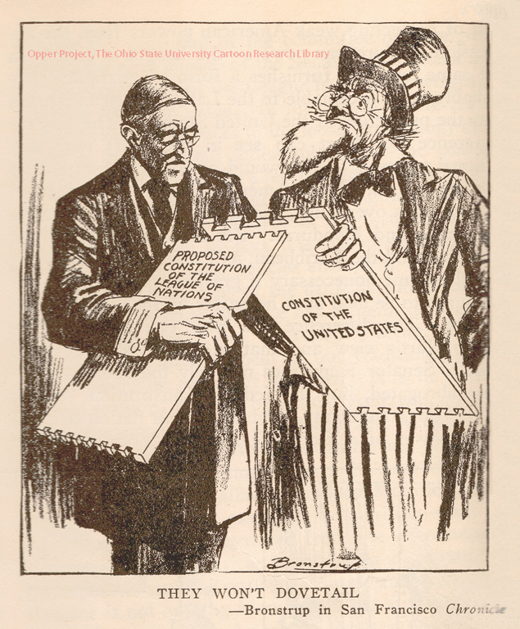
2
Notes:
Why didnt the US Join the League?

Slide 4
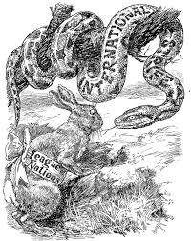
3
Notes:
Without the US what will happen to the league?

Slide 5
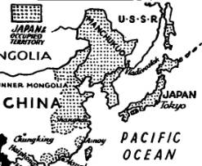
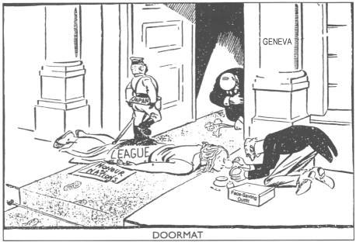
4
Notes:
What does the cartoon suggest about the effectives of the league of nations?

Slide 6
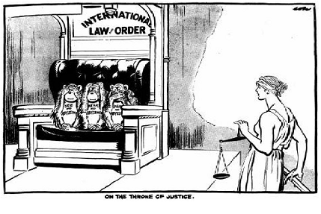
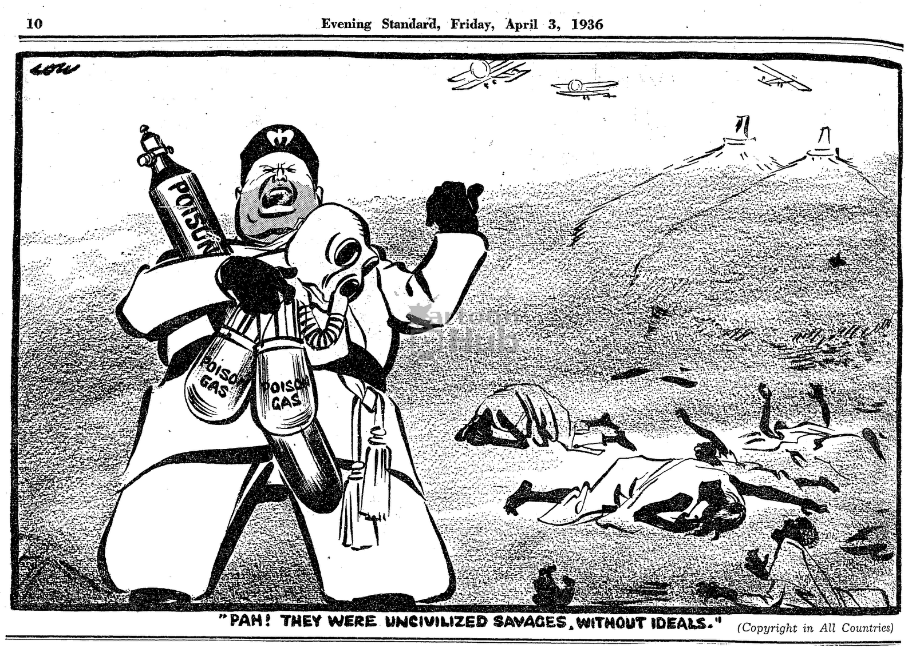
5
Notes:
Mussilini invades Ethiopia. What kinds of weapons did he unleash on them?
Where do you think the Ethiopians turned to for help?
What did the League of Nations do?

Slide 7
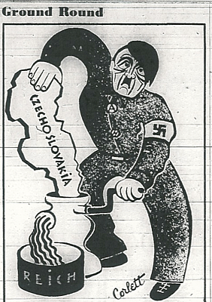
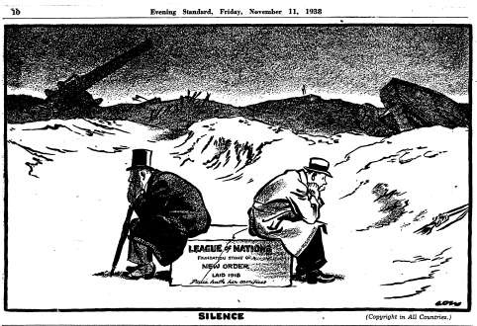
5
Notes:
What country did Hitler conquer?
In 1939 Hitler invades and conquers Czechoslovakia and than 6 months later he invades Poland starting WW2.
What was the leagues response?
Why? What was the league really worried about starting?

Slide 8
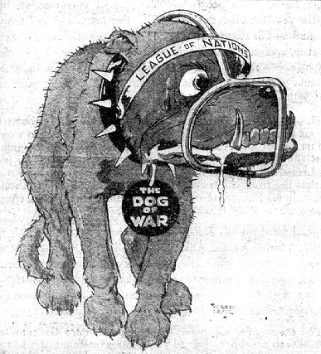
6
Notes:
How accurate is this cartoon?

Slide 9
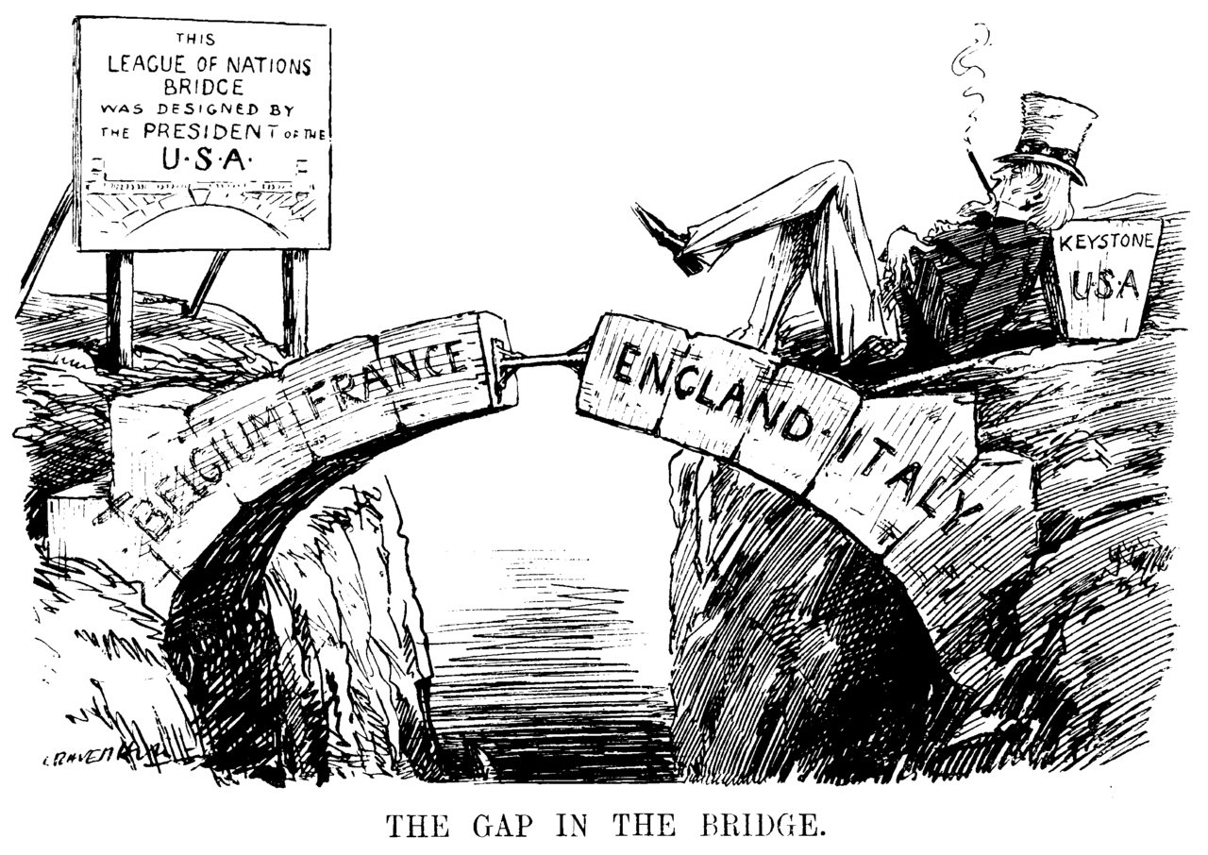
7
Notes:
What does the cartoon say is missing to make the league strong?

Slide 10
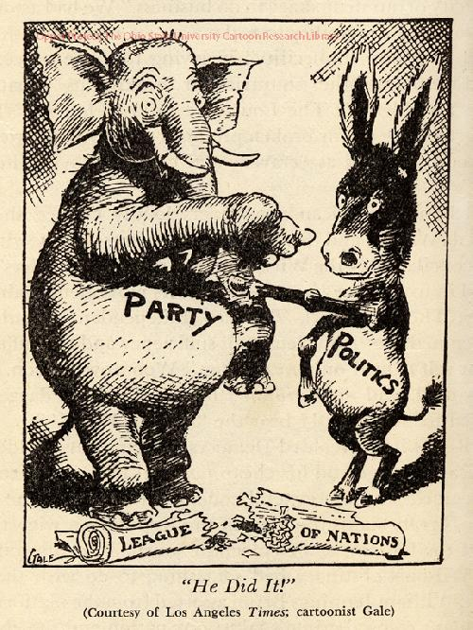
8
Notes:
What does the cartoon suggest is to blame for America’s failure to join the league?

Slide 11
9
Notes:
What does the cartoon suggest about the those who do not believe a league of nations is possible?

Slide 12
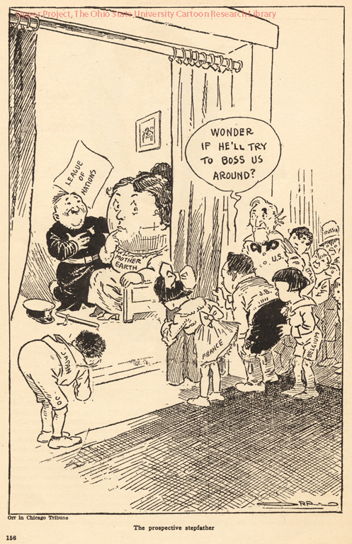
10
Notes:
What are some countries you see? Which one is the US?
What is the US concerned about would happen if they joined the League?

