Slide 1
Dairy Queen, GEICO, Fruit of the Loom, Pampered Chef, and Heinz Ketchup
WHAT DO THEY ALL HAVE IN COMMON?

Slide 2
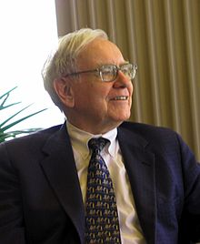
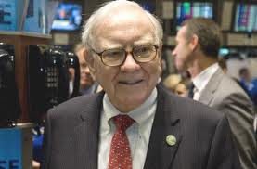
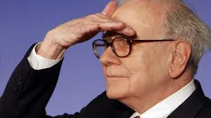
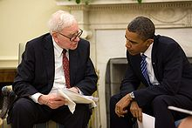
All owned by: Warren Buffet
Who: A WEALTHY INVESTOR

Slide 3
1. Why do people care?
→Worth over 37 Billion dollars (2nd richest man in the US...Bill gates is #1)
2. How did he get rich?
→Investing in stock market.
3. His mutual fund Berkshire Hathaway (Ticker Symbol: BRK/A and BRK/B) invests in and buys companies
4. Companies owned by Berkshire:
Ex: Dairy Queen, GEICO, Fruit of the Loom, Pampered Chef, and Heinz Ketchup

Slide 4
5. It is generally good advice to invest in companies Berkshire Hathaway invests in:
American Express (AXP): Credit Cards
Coca-Cola (KO): Beverage
IBM (IBM): Technology
Procter and Gamble (PG): Consumer Goods
M&T Bank (MTB): Banking
CarMax (KMX): Retail
Bank of American (BAC): Banking
Nike (NKE)
Bloomin Brands (BLMN): They own Outback Steakhouses/Carrabbas
Wells Fargo(WFC): Banking
Kraft Foods (KRFT): Food
ConocoPhillips (COP): Gas
Ingersoll Rand (IR): Industrial products
Home Depot (HD)
Johnson and Johnson (JNJ): Drugs
General Electric (GE)
Costco (COST)
Lowes (LOW)

